Slide 1

ANALYSIS OF EMERGENCY RESPONSE SERVICES DATA TO DETERMINE EFFICIENT POSITIONS OF THE RESPONSE TEAMS
TEAM:
Harsh Yadav (hy1217)
Datta Sainath D (dsd298)
Madhu Kiran Gudivada (mg5309)

Slide 2
BACKGROUND
In recent times, there is a striking increase in need of emergency services relating to fire accidents.
It has a severe consequences on individuals, economy and environment.
The major reason for failure to respond to an emergency in time is the delay of emergency vehicles.
It leads to human loss and can cause substantial financial losses.
PROBLEM STATEMENT
Aim to analyze data provided by NYC Open data website about the fire incidents in New York City.
Identify efficiency of fire department of NYC in terms of response time to an incidents.
Identify zip codes that have more number of fire incidents to increase assistance.
Identify suitable location for installing new fire stations to reduce response time.
Identify season and months in which more fire incidents occur.
Identify average response time of fire department based on season and months.
*
‹#›

Slide 3
USE CASE
Analysis performed using PySpark to analyze data.
Created heatmap to identify areas which have greater response time to the incident by Fire Department.
Created plots to determine response time by each Season and Month.
Created plots to determine number of incidents by each Season and Month.
Created heatmap to identify zip codes with highest number of incidents.
Used Clustering Algorithm to identify new locations for fire stations to reduce response time.
*
‹#›

Slide 4
TECHNOLOGIES USED
PySpark - For analyzing our huge dataset and getting insights from the data.
R- For creating interactive visualizations.
Tableau- For creating interactive heatmaps.
Google Maps API- For displaying the ideal new locations for fire stations.
Spark ML - For running the clustering algorithm
WHAT WE LEARNT
Handling multi GB files and analyzing them.
Real life implementation of Map-Reduce operations.
Getting insights from data and solving problems using it.
Creating interactive Visualizations to analyze results.
Not to stress if we see huge data in future.
*
‹#›

Slide 5
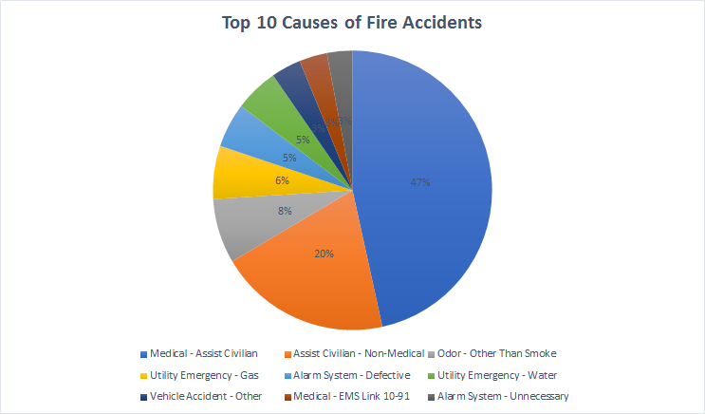
TOP 10 CAUSES OF FIRE ACCIDENTS
*
‹#›

Slide 6
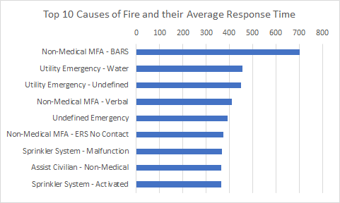
TOP 10 CAUSES OF FIRE ACCIDENTS AND THEIR AVERAGE RESPONSE TIME
*
‹#›

Slide 7
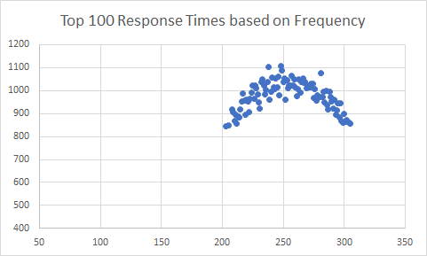
TOP 100 RESPONSE TIMINGS BASED ON FREQUENCY
*
‹#›

Slide 8
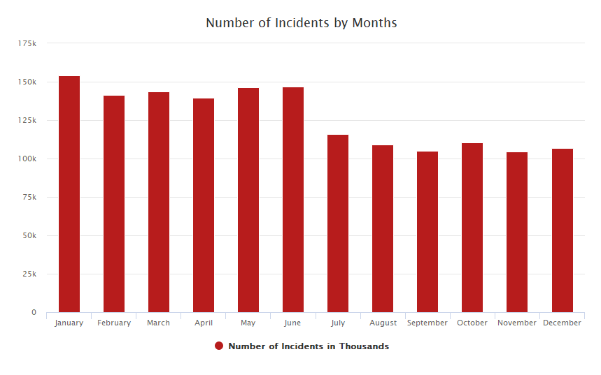
NUMBER OF INCIDENTS BY MONTH
More number of incidents occur during the first half of the year as compared to the second half.
*
‹#›

Slide 9
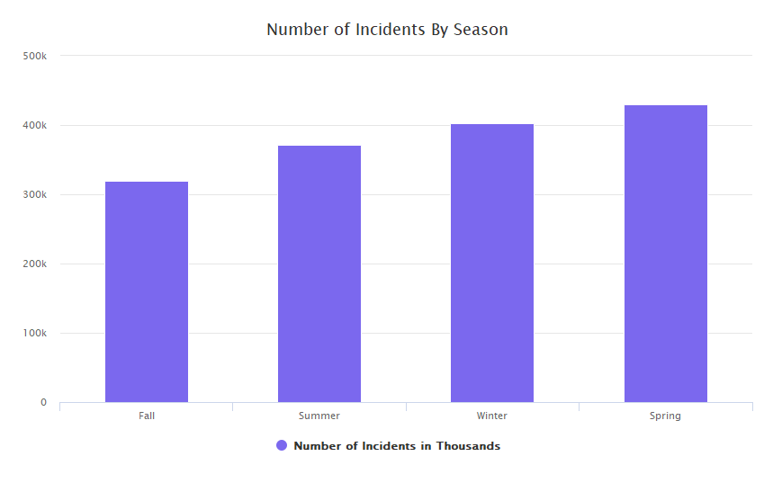
NUMBER OF INCIDENTS BY SEASON
Most of the Incidents occur during Spring and Winter due to weather conditions.
*
‹#›

Slide 10
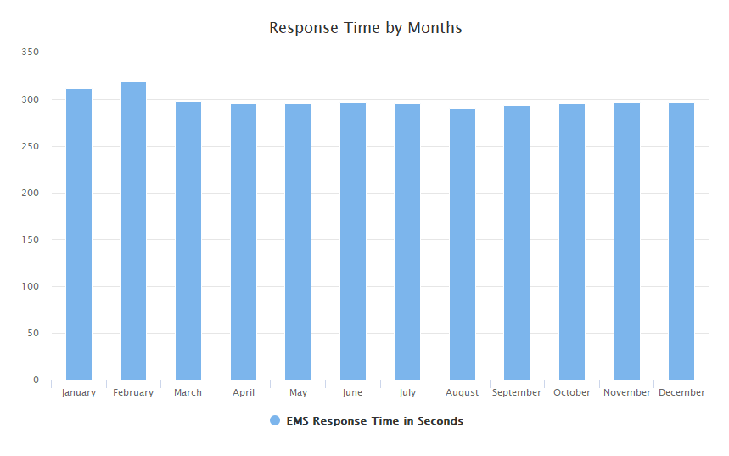
AVERAGE RESPONSE TIME BY MONTH
Response time is almost similar for all months, but a little more in January and February, which represents good service by the fire department.
*
‹#›

Slide 11
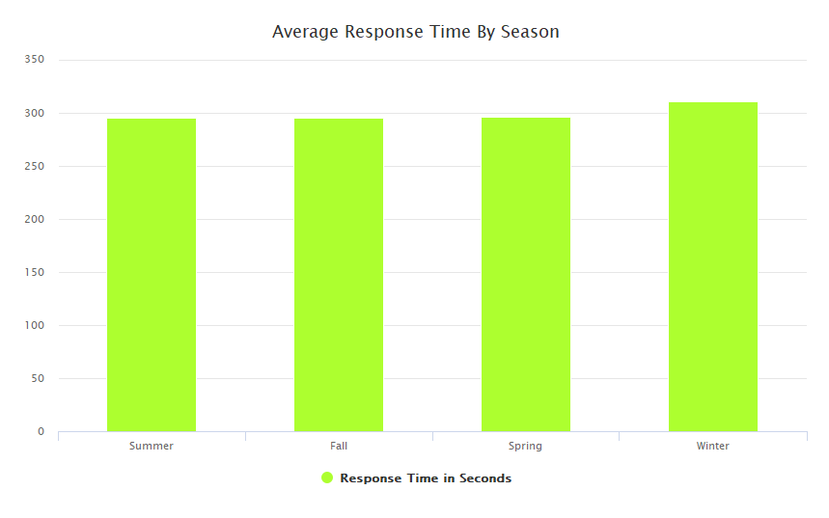
AVERAGE RESPONSE TIME BY SEASON
Response time is almost similar for all seasons, but is a little high during the winter season.
*
‹#›

Slide 12
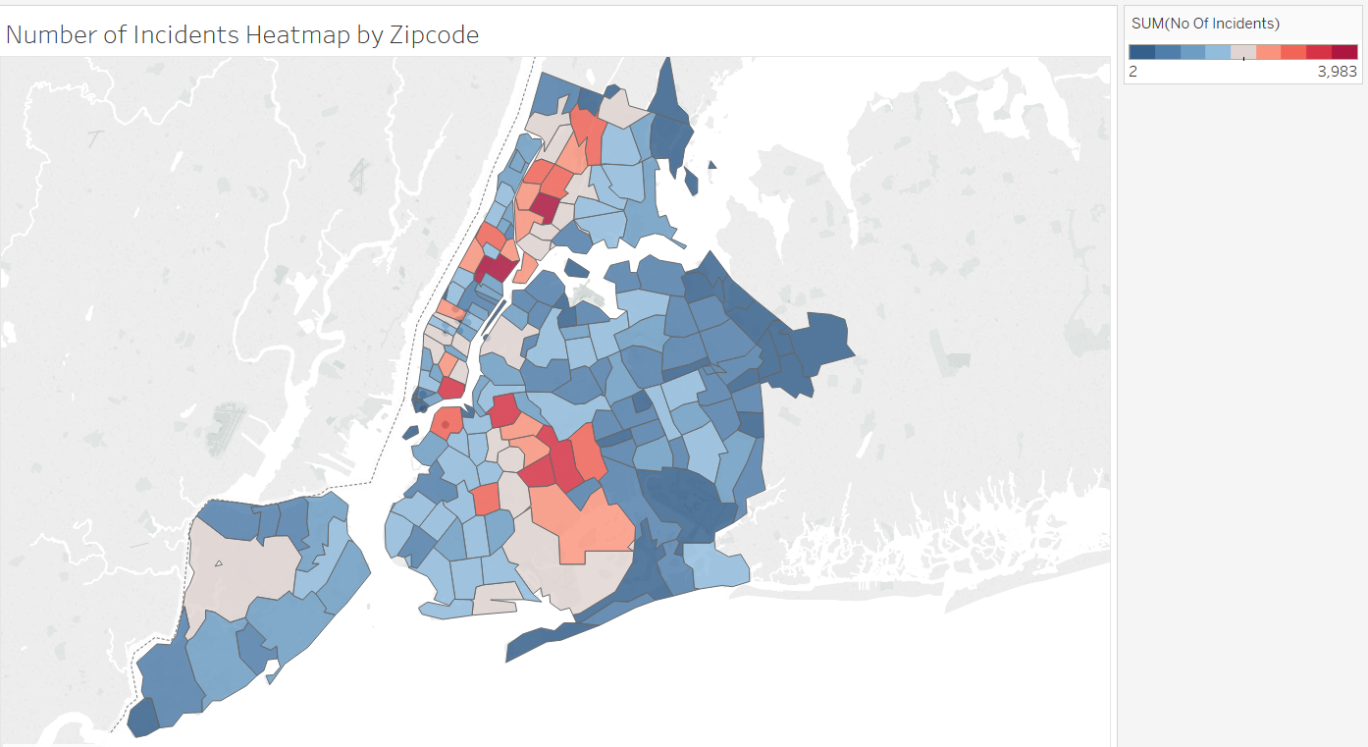
NUMBER OF INCIDENTS BY ZIP CODE
Representation of Number of Incidents by Zip Code where the red color represents more number of incidents and blue represents less number of incidents. So, we can infer that locations with more number of incidents need to be monitored for the cause.
*
‹#›

Slide 13
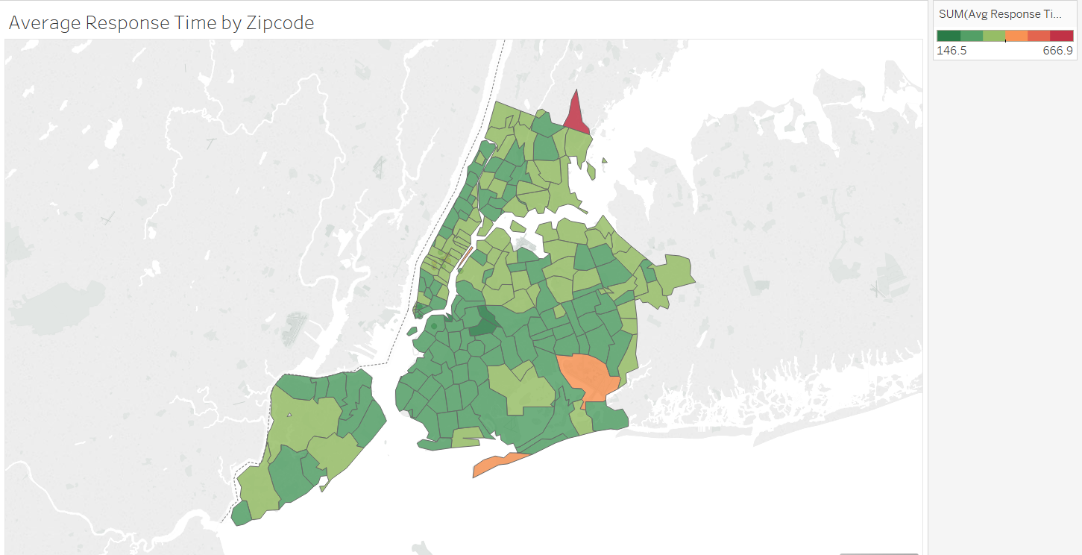
AVERAGE RESPONSE TIME BY ZIPCODE
Representation of Average Response Time by Zip Code where the red color represents more response time and green represents less response time. So, we can infer that locations with more number of incidents need more assistance.
*
‹#›

Slide 14
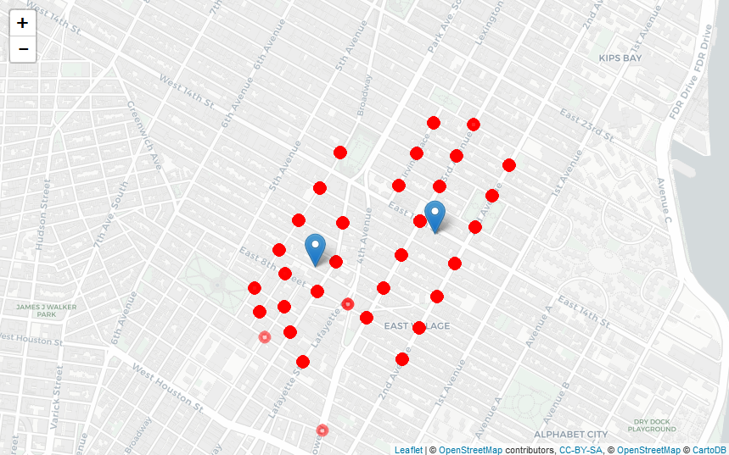
FIRE INCIDENTS IN ZIP CODE 10003
Incident locations in Zip Code 10003 marked with red dots and Blue markers represent the ideal new locations for installing new fire stations.
*
‹#›

Slide 15
1
THANK YOU!
*
‹#›

